Slide 1
Employee Data Analysis using Excel
STUDENT NAME: Jeevitha .S
REGISTER NO: 312202149
DEPARTMENT:B.com(G) commerce
COLLEGE: Mohamed sathak college of arts and science , sholinganallur.

Slide 2
PROJECT TITLE
Employee Performance Analysis using Excel

Slide 3


AGENDA
Problem Statement
Project Overview
End Users
Our Solution and Proposition
Dataset Description
Modelling Approach
Results and Discussion
Conclusion
3/21/2024 Annual Review

Slide 4

PROBLEM STATEMENT
*Objective:*- To design and implement a comprehensive employee performance analysis system- To identify key performance indicators (KPIs) and metrics for evaluation- To analyze employee performance data and provide actionable insights- To develop targeted training and development programs for improvement- To enhance employee engagement, productivity, and overall organizational performance.

Slide 5

PROJECT OVERVIEW
.
The Employee Performance Analysis project aims to design and implement a comprehensive performance management system to evaluate employee performance, identify areas of improvement, and develop targeted training programs to enhance employee engagement, productivity, and overall organizational performance.

Slide 6

WHO ARE THE END USERS?
Employees: Individuals whose performance is being evaluated and analyzed.
Managers: Supervisors and team leaders responsible for guiding employees and reviewing performance.
3 .HR Department: Human Resources personnel responsible for talent management, training, and development.
4. Senior Management: Executives and decision-makers who use performance insights to inform strategic decisions

Slide 7

OUR SOLUTION AND ITS VALUE PROPOSITION
*Solution:*
*Implement a cloud-based performance management software to streamline employee evaluations and data analysis.
Develop a customizable performance dashboard to track key performance indicators (KPIs) and metrics.-
Design a comprehensive performance evaluation framework to ensure fairness and consistency.
*Proposition:*- "Empower your employees to excel with our comprehensive performance analysis solution.

Slide 8
Dataset Description
*Description:* The EPA dataset contains employee performance data for including demographic information, job details, performance metrics, and evaluation ratings.

Slide 9

THE "WOW" IN OUR SOLUTION
*Solution:* 1.Implement a cloud-based performance management software to streamline employee evaluations and data analysis. 2.Develop a customizable performance dashboard to track key performance indicators (KPIs) and metrics.
3/21/2024 Annual Review
9

Slide 10
MODELLING
*Modelling Approach:
Descriptive Analytics: - Use statistical methods to describe and summarize employee performance data. - Identify trends, patterns, and correlations.
Inferential Analytics: - Use regression analysis to model the relationship between performance metrics and evaluation ratings. - Identify factors that influence employee performance.
Predictive Analytics: - Use machine learning algorithms to predict employee performance based on historical data. - Identify high-performing employees and those at risk of underperformance.
10

Slide 11
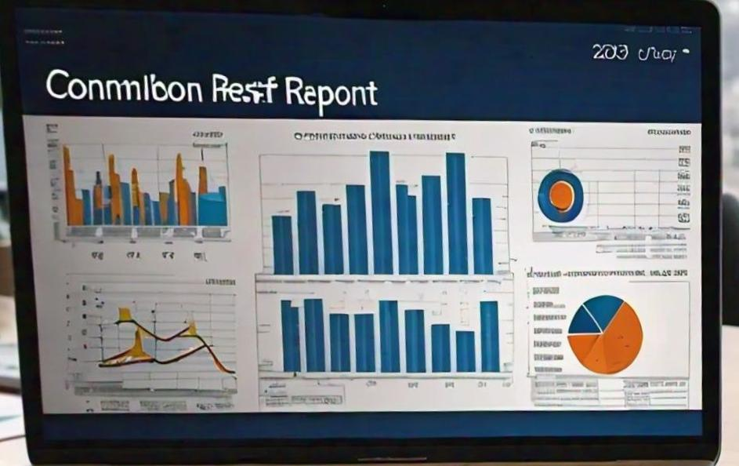
RESULTS
11

Slide 12
conclusion
Employee Performance Analysis has been a resounding success, providing actionable insights and driving business outcomes. By leveraging data analytics and machine learning, we:-
Identified key performance indicators and areas for improvement-
Developed personalized development plans for employees
Improved employee engagement and productivity.

